Slide 1

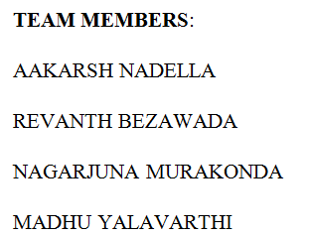
PREDICTIVE
ANALYTICS USING
R PROGRAMMING

Slide 2
ABSTRACT
Predictive analytics is an area of data mining that deals with extracting information from data and using it to predict trends and behavior patterns. The use of predictive analytics in government is presently less common but using it one can explore how tax administrations could make use of data analytics algorithm to enhance tax compliance among the taxpayers and predict future tax of the government based on past observations. Gaussian process is used for predictive analytics in mini project. In this major project, Artificial Neural Networks and Regression methods are used to predict the future values based on past observations from Income tax data set of the Government and observe which method gives accurate value. Feature engineering methods such as recursive feature elimination which involves the use of random forest algorithm will be used for attribute selection.
Keywords: Predictive Analytics, Regression, Artificial Neural Networks, Data Mining, R language, Statistical Computing, Machine Learning, Tax Administration, Feature Engineering, Random forest.

Slide 3
LITERATURE REVIEW
Dr. M. Venkatesan, E. Sreehari and J. Velmurugan proposed “A Survey Paper on Climate Changes Prediction Using Data mining”(2016)
Comparison is made in the other papers, which shows that decision trees and k-mean clustering are best suited data mining technique for this application.
With the increase in size of training set, the accuracy is first increased but then decreased after a certain limit. With all the observations made the regression is considered to be best method for prediction.

Slide 4
Cont’d
Luckyson Khaidem, Snehanshu Saha and Sudeepa Roy Dey proposed “Predicting the direction of stock market prices using random forest”
They used random forest classifier to build predictive model and model has proved to be really robust in predicting future direction of stock movement.
The robustness of model has been evaluated by calculating various parameters such as accuracy, precision, recall and specificity The achieved accuracy is in the range 90-95% for long term prediction.

Slide 5
Cont’d
A. Correa Bahnsen, Djamila Aouada, Aleksandar Stojanovic and Björn Ottersten have proposed “Feature engineering strategies for credit card fraud detection”
They used decision tree (DT), logistic regression (LR) and a random forest (RF) algorithms to check the performance of feature engineering.
They found that by preprocessing the data using feature engineering techniques in order to include consumer behavior, the performance increases by more than 200% compared to using only raw transaction information.

Slide 6
Cont’d
Abhishek Kar has proposed “Stock Prediction using Artificial Neural Networks”
He used Back propagation algorithm and the disadvantages are :
Back propagation learning requires input scaling or normalization.
Back propagation requires the activation function used by the neurons to be differentiable.
He found that the prediction is fairly accurate unless there is a huge and sudden variation in the actual data, where it becomes impossible to exactly predict the changes.
He also proved the hypothesis that stock markets are actually unpredictable.

Slide 7
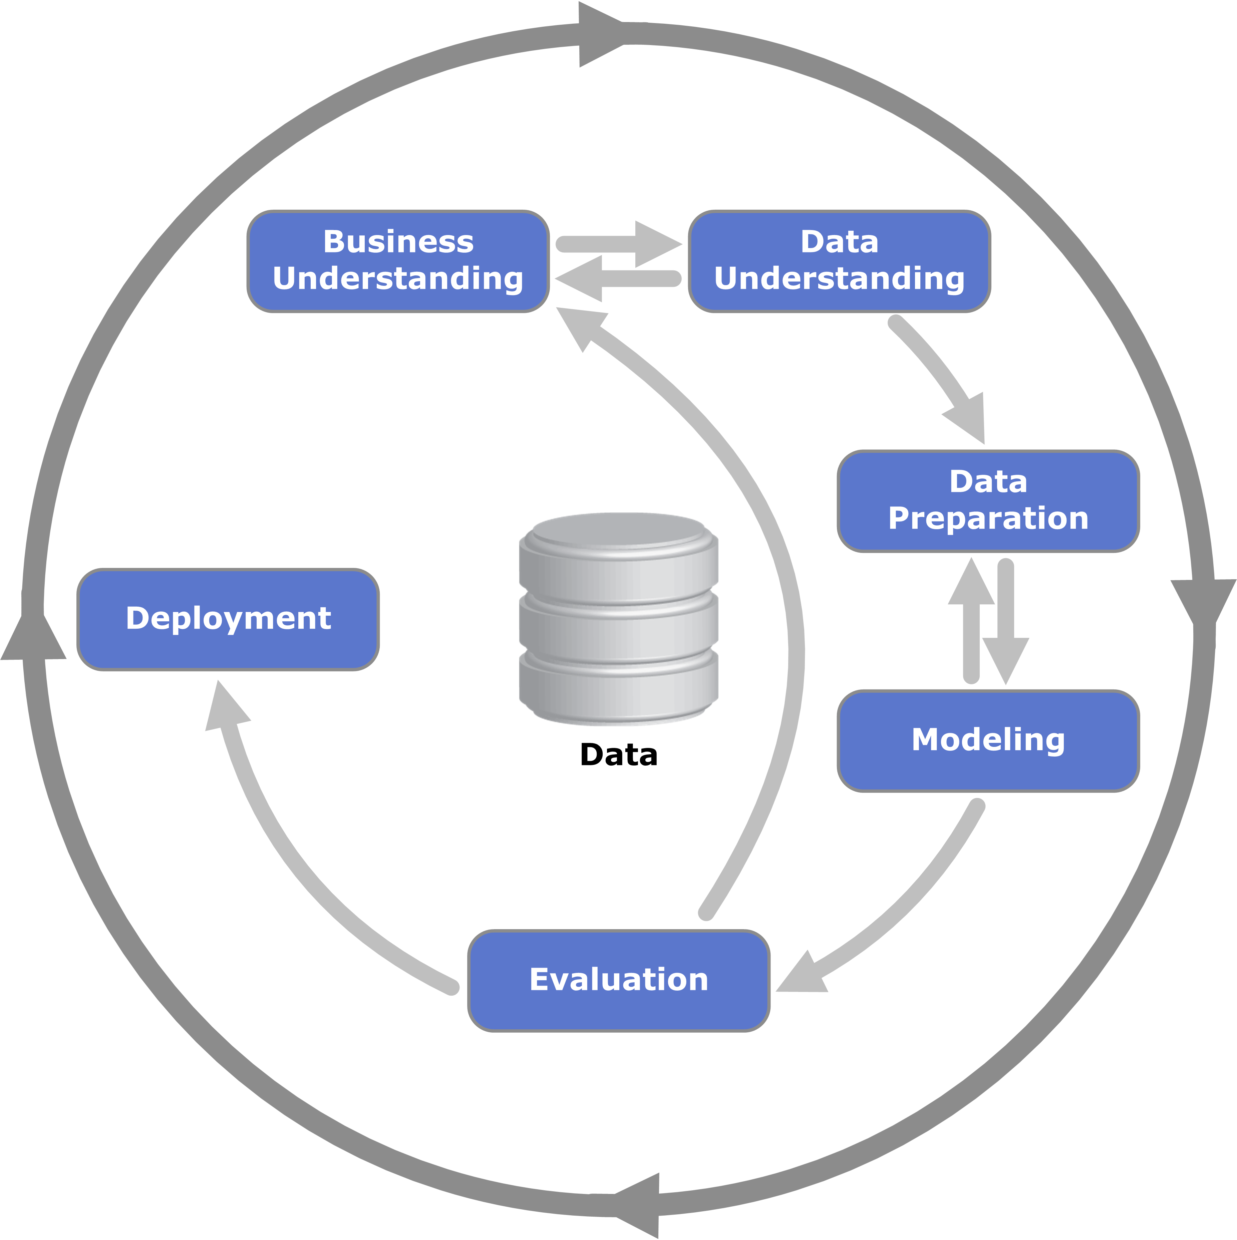
LIFE CYCLE
CRISP-DM :
Cross Industry Standard Process for Data Mining, commonly known by its acronym CRISP-DM was a data mining process model that describes commonly used approaches that data mining experts use to tackle problems.

Slide 8
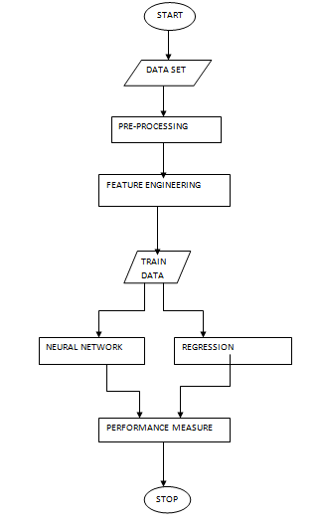
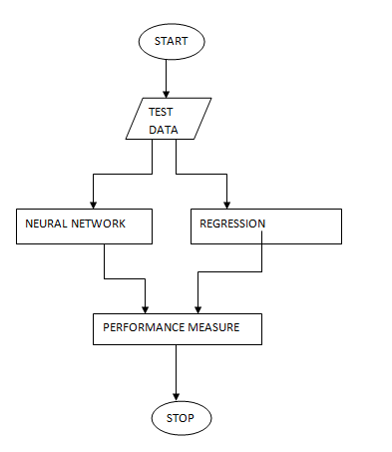
FLOWCHART

Slide 9
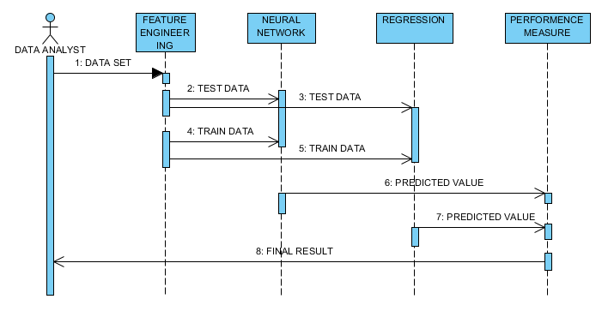
SEQUENCE DIAGRAM

Slide 10
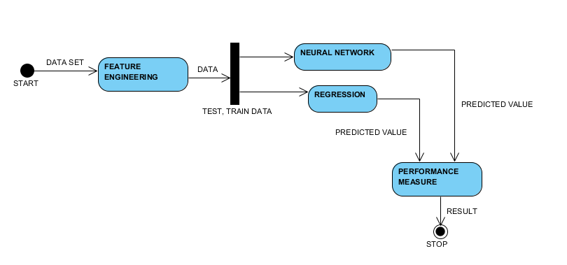
ACTIVITY DIAGRAM

Slide 11
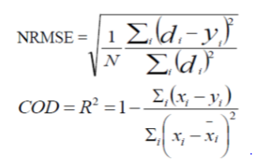
METHODOLGY
Input: Dataset
Step1: Read the input dataset
Step2: Preprocessing using Z-score normalization such that it will help speed up the learning phase
Xnew = (Xold – Mean) / SD
Step3: Apply feature selection method “ Recursive Feature Elimination” that uses Random Forest Algorithm on the dataset.
Step 4: Choose X = { Xtrain, Xtest }
Step 5: Build predictive model using neural networks and regression.
Step 6: Evaluate the model using NRMSE and COD.

Slide 12
Generalized R procedure for predictive analytics using ANN
Input: Dataset
Step1: Read the input dataset
Step2: Add a column for which we want to predict
Step3: Preprocessing using Z-score normalization such that it will help speed up the learning phase
Step4: Assign initial weights to neurons randomly selected from N(mean, std) mean and standard deviation.
Step 5: Obtain a nonlinear model
Step 6: Evaluate the model using NRMSE and COD

Slide 13
Generalized procedure for predictive analytics using ARX
Input: Dataset
Step1: Read the input dataset
Step2: Add a column for which we want to predict
Step3: Preprocessing using Z-score normalization such that it will help speed up the learning phase
Step4: Finding best set of features for creating a predictive model because some features are better for predicting the target than others. Also, some features have a strong correlation with other features, so they will not add much new information to the model, and thus can be removed
Step 5: Predict the target values using Jackknife regression in combination with train-and-test method and the cross-validation method
Step 6: Evaluate the model using NRMSE and COD

Slide 14
REFERENCES
[1] Dr. M. Venkatesan, E. Sreehari and J. Velmurugan (2016) ‘A Survey Paper on Climate Changes Prediction Using Data mining’, International Journal of Advanced Research in Computer and Communication Engineering, 5(2). Dr. M. Venkatesan, E. Sreehari and J. Velmurugan (2016) ‘A Survey Paper on Climate Changes Prediction Using Data mining’, International Journal of Advanced Research in Computer and Communication Engineering, 5(2).
[2] Luckyson Khaidem, Snehanshu Saha and Sudeepa Roy Dey (2016) ‘Predicting the direction of stock market prices using random forest’, Applied Mathematical Finance, 00(00).
[3] Alejandro Correa Bahnsen, Djamila Aouada, Aleksandar Stojanovic and Björn Ottersten (2016) ‘Feature engineering strategies for credit card fraud detection’, Expert Systems With Applications, , pp. 134–142.
[4] Abhishek Kar (2016) ‘Stock Prediction using Artificial Neural Networks’, .

Slide 15
THANK YOU

